Slide 1
R Worship Day 3: Intro to Statistics in R
Drew Allen

Slide 2
Getting Started
Start a new project in a new directory in R Studio
Download the files we will be using today into this new directory:
shells.csv
gala.txt
mangroves.csv
rats.csv
binary.csv
dioxin.csv

Slide 3
Topics Covered
Statistical Distributions
Summary Statistics
T-tests
Regression (simple linear, multiple linear)
Analysis of Variance
One-way ANOVA
Two-way ANOVA
ANCOVA
Generalised linear models

Slide 4
Statistical Distributions

Slide 5
Some Basic Definitions
Random Variable – a variable whose value is not known with certainty, e.g. coin flip
Random Variate – particular outcome of a random variable, e.g. heads
Probability – denotes relative frequency of occurrence of particular value, e.g. p(heads) = 0.5
Probability distribution yields the probability of
Each value of a random variable (discrete distribution)
the value of a random falling within a particular interval (continuous distribution)

Slide 6
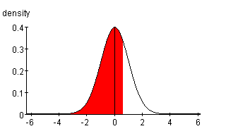
Probability density (i.e. height) at x PDF
dnorm(x,mean=0,sd=1)
P(t>a)
x

Slide 7
Probability that variate t <= x Cumulative Distribution Function, CDF
pnorm(x,mean=0,sd=1,lower.tail=TRUE)
P(t>a)
P(t<=x)
x

Slide 8
Probability that variate t > x Complementary CDF
pnorm(x,mean=0,sd=1,lower.tail=FALSE)
P(t>a)
P(t>x)
x

Slide 9
Question: What is this sum?
pnorm(x,mean=0,sd=1,lower.tail=TRUE)+ pnorm(x,mean=0,sd=1,lower.tail=FALSE)

Slide 10
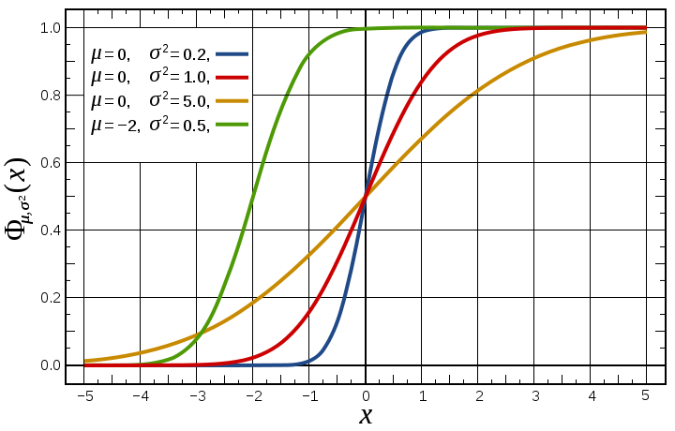
At what value of x is P(t<=x) = 0.4?
qnorm(0.4,mean=-2,sd=sqrt(0.5))

Slide 11
Sampling from a distribution
hist(rnorm(1000,mean=12,sd=6))

Slide 12
Functions have required and optional arguments
Works fine (no required arguments)
q()#quits R
Doesn’t work:
rnorm()#missing argument for n, which has no default
Does work (caution: computer assigns values for some arguments!)
rnorm(100) #takes default arguments
Does work (all arguments specified by user)
rnorm(100,mean=1,sd=4)
rnorm(mean=1,sd=4,n=100)

Slide 13
Exercise 1: Using R as a Statistics Table
Generate a sample of 1000 variates from a normal distribution of mean 10 and standard deviation 5 using rnorm
For this sample, calculate what fraction of the points take values <5 (hint: subset the vector using [ ], and use length)
Using pnorm, calculate the theoretically predicted fraction of points that should take values < 5

Slide 14
Exercise 1: Answer
x <- rnorm(1000,mean=10,sd=5)
length(x[x<5])/length(x)
pnorm(5,mean=10,sd=5)

Slide 15
Built-in Probability Distributions: for the list, type ?Distributions
Continuous distributions
Discrete distributions
Normal (dnorm)
T (dt)
Chi-squared (dchisq)
F (df)
Exponential (dexp)
Uniform (dunif)
Beta (dbeta)
Cauchy (dcauchy)
Logistic (dlogis)
Lognormal (dlnorm)
Gamma (dgamma)
Weibull (dweibull)
Binomial (dbinom)
Poisson (dpois)
Geometric (dgeom)
Hypergeometric (dhyper)
Negative binomial (dnbinom)

Slide 16
Other Distributions Use Similar Syntax
NORMAL DISTRIBUTION
dnorm(x, mean = 0, sd = 1, log = FALSE)
pnorm(q, mean = 0, sd = 1, lower.tail = TRUE, log.p = FALSE)
qnorm(p, mean = 0, sd = 1, lower.tail = TRUE, log.p = FALSE)
rnorm(n, mean = 0, sd = 1)
UNIFORM DISTRIBUTION
dunif(x, min=0, max=1, log = FALSE)
punif(q, min=0, max=1, lower.tail = TRUE, log.p = FALSE)
qunif(p, min=0, max=1, lower.tail = TRUE, log.p = FALSE)
runif(n, min=0, max=1)

Slide 17
Exercise 2 Using R as a Statistics Table
What is the probability that a random variate from a gamma distribution with a shape parameter = 3 and scale parameter = 1 is > 0.68? [use pgamma]
What is the probability that a random variate from an exponential distribution with rate = 0.05 lies between 1 and 10? [use pexp]

Slide 18
Exercise 2: Answers
pgamma(0.68,shape=3, scale = 1,lower.tail=F)
1- pgamma(0.68,shape=3, scale = 1)
pexp(10,rate=0.05) - pexp(1,rate=0.05)

Slide 19
Exercise 3: Using R as a Statistics Table
What is the probability that a random sample of 15 people has 2 people with the same birthday? [Hint: ?pbirthday]
What is the probability that a random sample of 25 martians includes 2 martians with the same birthday? [Hint: a year on Mars is 687 days]

Slide 20
Exercise 3 Answer: R functions arguments can be matched positionally or by name
pbirthday(n = 15, classes = 365, coincident = 2)
pbirthday(15, 365, 2)
pbirthday(classes = 365, 15, 2)
pbirthday(15, coincident = 2)
pbirthday(25, coincident = 2) #wrong answer for martians
pbirthday(25,687,2) #right answer for martians

Slide 21
Statistical distributions provide a means to perform simulations
#using r for simulation of 1D random walker
steps<-rnorm(n=10000,mean=0,sd=1)
distance.from.origin <- cumsum(steps)
plot(distance.from.origin,type='l')

Slide 22
Use of set.seed() for reproducible random results
#using r for simulation of 1D random walker
set.seed(1)
steps<-rnorm(n=10000,mean=0,sd=1)
distance.from.origin <- cumsum(steps)
plot(distance.from.origin,type='l')

Slide 23
Summary Statistics

Slide 24
Some Functions for Calculating Summary Statistics
Minimum: min()
Maximum: max()
Range (Minimum and Maximum): range()
Mean: mean()
Median: median()
Quantiles: quantile()
Interquartile range: IQR()
Variance: var()
Standard Deviation: sd()
Summary: summary()
Stem & Leaf Plot: stem()
Boxplot: boxplot()
QQ Plot: qqnorm(), qqline()

Slide 25
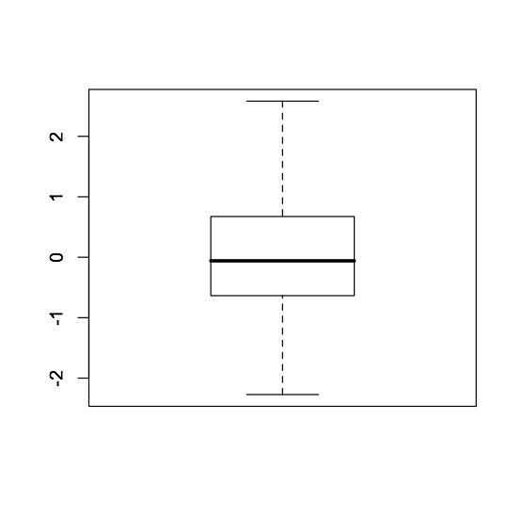
Functions for Calculating Summary Statistics
75% quantile
1.5xIQR
>x<-rnorm(100)
>boxplot(x)
Median
25% quantile
IQR
1.5xIQR
IQR= 75% quantile -25% quantile= Inter Quantile Range
Everything above or below are considered outliers

Slide 26
QQ Plot
Many statistical methods make some assumption about the distribution of the data (e.g. Normal)
The quantile-quantile plot provides a way to visually verify such assumptions
The QQ-plot shows the theoretical quantiles versus the empirical quantiles. If the distribution assumed (theoretical one) is indeed the correct one, we should observe a straight line.

Slide 27
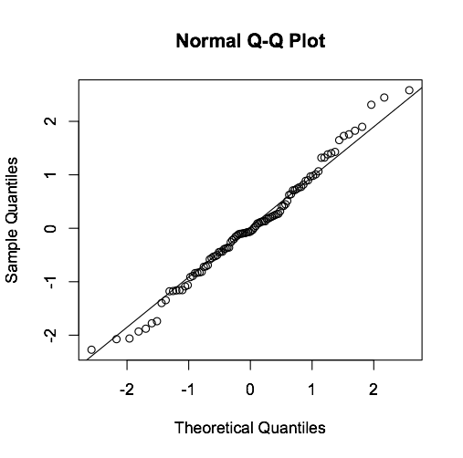
QQ Plot
x<-rnorm(100)
qqnorm(x)
qqline(x)

Slide 28
Functions for Calculating Summary Statistics
Two functions are extremely useful for calculating summary statistics for subsets of data:
apply() (calculates function on a column-by –column or row-by-row basis)
tapply() (groups data in one column based on values in another column)

Slide 29
T test

Slide 30

What does Student’s t distribution have to do with Guinness beer?

Slide 31
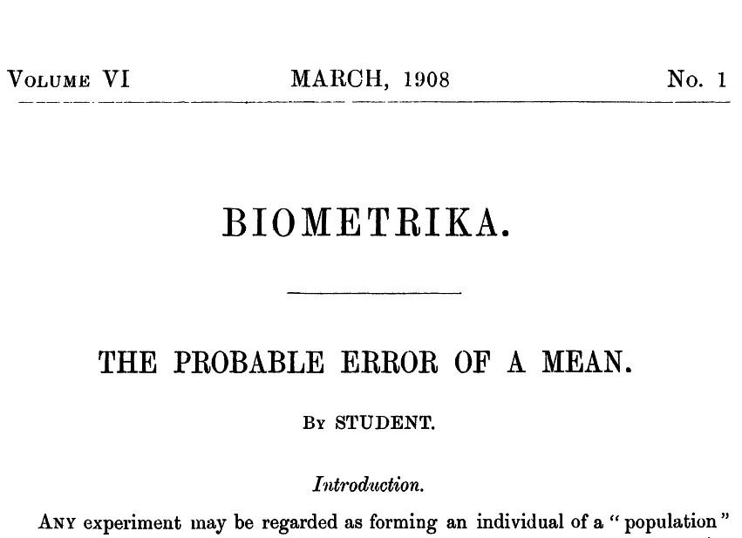

Slide 32
T distribution
The t distribution was introduced by William Gosset, a chemist working for Guinness brewery in Ireland
He published his work under the pen name “Student” because Guinness regarded the fact that they were using statistics to help with brewing to be a trade secret

Slide 33
T-test Example: Shell Size Data
We’re on Trunk Reef in the Great Barrier Reef and we have collected random samples of one shell species from two locations, one wave-exposed and the other sheltered.
We want to determine if shells differ in size between these two environmentally different locations.
The data are the shell lengths in millimetres for the two locations.
Does mean shell size differ between the two locations?

Slide 34
Specifying Dependent & Independent Variables in R
Formula notation for many functions in R:
boxplot(y ~ x,data = my.data) # boxplot
lm(foot~gender,data = my.data) # one-way ANOVA
t.test(y ~ x,data = my.data) # t-test
t.test(response~predictor,data=my.table)
dependent
(response)
independent
(predictor)
dataframe

Slide 35
Exercise 4: Shell Size Data
Conduct a two-sample T test using the function t.test()
Type ?t.test for some help
Answer the following questions:
What is the mean difference, m, between the treatments?
What is the 95% CI for the difference?
According to the t test, is the difference significant at the P = 0.05 level for the two-tailed test?
According to the non-parametric analogue of the t test (Wilcoxon Rank Sum Test), is the difference significant at the P = 0.05 level for the two-tailed test? [Use wilcox.test]

Slide 36
Exercise 4 Answers
shells <- read.csv('shells.csv')
t.test(length~type,shells)
wilcox.test(length~type,shells)

Slide 37
More on T tests
# Welch two-sample t-test
t.test(length~type,shells)
# Student two-sample t-test
t.test(length~type,shells,var.equal=TRUE)
# one-sample t-test
# null hypothesis: mean shell size = 14mm
t.test(shells$length,mu=14)

Slide 38
Wilcoxon Rank Sum Test
This technique is non-parametric , meaning that it does not rely on assumptions that the data are drawn from a particular probability distribution.
Non-parametric methods are particularly suited to data that are not normally distributed.
Assumptions Wilcoxon Rank Sum Test:
random samples from populations
independence within samples and mutual independence between samples
measurement scale is at least ordinal

Slide 39
Monte Carlo Method
3.69
Monte Carlo (MC) methods – broad class of computational algorithms that rely on random sampling to solve problems
We can use MC to sample permutations
12
17
14
21
16
18
13
18
11
14
20
22
14
16
16
17
18
Mean: 14.56
Mean: 18.25
Diff: 3.69
Notes:
Rather than looking at all combinations

Slide 40
Shuffle together
3.69
18
17
17
16
20
16
18
14
13
14
21
14
18
12
22
11
16

Slide 41
Randomly sample
3.69
0.15
Split randomly, ensure same number in each group as original treatments
Mean: 16.22
Mean: 16.38
Diff: 0.15
13
20
16
18
18
18
22
14
21
14
16
14
17
11
12
17
16

Slide 42
Shuffle together
3.69
0.15
18
17
17
16
20
16
18
14
13
14
21
14
18
12
22
11
16

Slide 43
Randomly sample
3.69
0.15
-3.86
Mean: 18.11
Mean: 14.25
Diff: 3.86
18
20
16
12
14
11
13
18
21
14
16
14
17
18
22
17
16

Slide 44

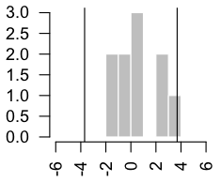
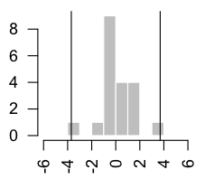
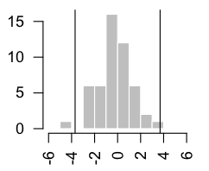
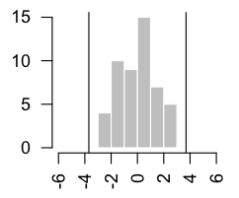
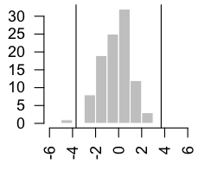
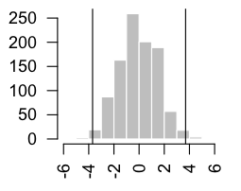
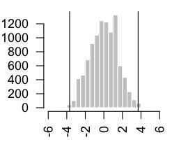
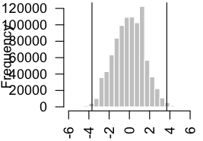
Monte Carlo Method
10 samples, 0 >= diff
p = 0
20 samples, 1 >= diff
p = 0.05
50 samples, 1 >= diff
p = 0.02
50 samples, 0 >= diff
p = 0
100 samples, 1 >= diff
p = 0.01
1,000 samples, 8 >= diff
p = 0.008
10,000 samples, 65 >= diff
p = 0.0065
1,000,000 samples, 7242 >= diff
p = 0.007242
This took
a while!
Notes:
Ho: depends on 1- or 2- tail test.
Exact, because all combinations were accounted for.

Slide 45
Power Analysis
A very important part of planning research
Power is the conditional probability of rejecting the null hypothesis given that it is really false
1- Power = Type II error

Slide 46
Power Depends on:
α: significance level used
ES: Effect size of interest
n: sample size; a given effect is easier to detect with larger sample sizes
s²: estimated variance; it is harder detect effects between more variable populations

Slide 47
Exercise 5: Power Analysis of Shell Data
In the command window, learn how to conduct a power analysis using ?power.t.test
I have calculated delta and sd for you
Using this function, calculate the statistical power of the test
Now use this function to determine how large a sample size would be required to reject the null hypothesis at a significance level of 0.05 with 80% power

Slide 48
Exercise 5 Answers
power.t.test(n=51,delta=13.36275-15.56863,sd=sqrt(18.52549))
power.t.test(n=NULL,delta=13.36275-15.56863,sd=sqrt(18.52549),power=0.80)

Slide 49
Linear Regression

Slide 50
Linear Regression
Use gala <- read.table(...,header=TRUE,row.names=1) to import the file gala.txt into the dataframe gala
View the dataset using head(gala)

Slide 51
gala
Source
M. P. Johnson and P. H. Raven (1973) "Species number and endemism: The Galapagos Archipelago revisited" Science, 179, 893-895
Variables
Species the number of plant species found on the island
Endemics the number of endemic species
Area the area of the island (km^2)
Elevation the highest elevation of the island (m)
Nearest the distance from the nearest island (km)
Scruz the distance from Santa Cruz island (km)
Adjacent the area of the adjacent island (square km)

Slide 52
Investigate Distributions of Variables and Their Relationships
Generate a plot similar to the one below by typing plot(gala)

Slide 54
Ignore these issues and fit a linear model
Now fit a linear regression model by typing:
gala.model<-lm(Species~Area, data=gala)
Let’s look at the attributes of this object:
str(gala.model)
Name of function to fit OLS regression model
Response
Predictor(s)

Slide 55
Extractor functions allow you to get information on lm objects
coef(gala.model)
residuals(gala.model)
fitted.values(gala.model)
cooks.distance(gala.model)
summary(gala.model)
anova(gala.model)

Slide 56
Assumptions of Linear Regression
Linearity of the relationship between dependent and independent variables
Independence of the errors (no serial correlation)
homoscedasticity (constant variance) of the errors
normality of the error distribution

Slide 57

Let’s evaluate these assumptions
To evaluate assumptions type:
plot(gala.model)
Theory:
Leverage is a measure of how far an independent variable deviates from its mean
Cook’s distance
measures the influence of an observation on the overall model:
Y_{j} is the prediction from the full regression model for observation j
Y_{j (i)} is the prediction for observation j from a refitted regression model in which observation i has been omitted
Frequently proposed rules of thumb include focusing on points with distances D_{i} > 1 or > 4/n

Slide 59
Exercise 6: Independent analysis of gala data
Transform species and area using the log10 transformation, e.g.
Refit the linear model using the log transformed data and assess whether model assumptions are upheld
Plot the data and model together using the functions plot() and abline()
Inspect the coefficients using summary()

Slide 60
Exercise 6: Answer
gala$log.species<-log10(gala$Species)
gala$log.area<-log10(gala$Area)
gala.model<-lm(log.species~log.area, data=gala)
plot(log.species~log.area,gala)
abline(gala.model)

Slide 61
Fit of simple linear regression model
summary(gala.model)
95% confidence interval for fitted slope:
lower CI: 0.38860 + qt(.025,28)* 0.04160
Upper CI: 0.38860 + qt(.975,28)* 0.04160
confint(gala.model)
Estimate Std. Error t value Pr(>|t|)
(Intercept) 1.26106 0.06822 18.484 < 2e-16 ***
log.area 0.38860 0.04160 9.342 4.23e-10 ***
---
Signif. codes: 0 '***' 0.001 '**' 0.01 '*' 0.05 '.' 0.1 ' ' 1
Residual standard error: 0.3406 on 28 degrees of freedom
Multiple R-squared: 0.7571, Adjusted R-squared: 0.7484
F-statistic: 87.27 on 1 and 28 DF, p-value: 4.23e-10

Slide 62
Multiple linear regression
Extending analyses to multiple linear regression is straightforward using lm():
lm(y~x1 + x2,data)
Notation used for formulas (VERY general, applies to many statistical procedures in R):
Intercept only
lm(y~1,data)
Force-fit y versus x1 relationship through origin
lm(y~x1-1,data)
Include all variables in data.frame:
lm(y~.,data)
Include all variables in data.frame but x7:
lm(y~.– x7,data)
Include x1, x2 and their interactions:
lm(y~x1*x2,data)
lm(y~x1+x2+x1:x2)
Lm(y~x1*x2*x3 – x1:x2:x3) #drop 3-way interaction

Slide 63
Exercise 7 Formally test for effects of log.elevation after accounting for log.area
Fit a new model that includes both log.elevation and log.area
Null hypothesis: after account for the effects of area, elevation is not significant
How do we test this null hypothesis?
R knows what to do. Just type:
anova(lm1,lm2)

Slide 64
Exercise 7 Answer
gala$log.elevation <- log10(gala$Elevation)
gala.model2 <- lm(log.species~log.area+log.elevation,data=gala)
anova(gala.model,gala.model2)

Slide 65
Automated Model Selection
Several methods available:
Best subset selection
Stepwise selection
Fit using multiple criteria:
Statistical significance [logLik(lm1)-logLik(lm2)]
AIC [ AIC(lm1) - AIC(lm2)]
Key issue: need to first specify a full model
Controversial among statisticians due to multiple comparisons problem, but still useful for exploration

Slide 66
R Code for BE using step()
Use R function step
Need to define an initial model (the full model in this case, as produced by the R function lm) and a scope (a formula defining the full model)
ffa.lm <- lm(ffa~., data=ffa.df)
step(ffa.lm,direction='backward')

Slide 67
Forward Selection (FS) using step()
Start with a null model
Fit all one-variable models in turn. Pick the model with the best (i.e. lowest) AIC
Then, fit all two variable models that contain the variable selected in 2. Pick the one for which the added variable gives the best AIC
Continue in this way until adding further variables does not reduce the AIC

Slide 68
R Code for FS using step()
Use R function step
As before, we need to define an initial model (the null model in this case and a scope (a formula defining the full model)
# R code: first make null model:
ffa.lm = lm(ffa~., data=ffa.df)
null.lm = lm(ffa~1, data=ffa.df)# then do FS
step(null.lm, scope=formula(ffa.lm),
direction='forward')

Slide 69
R Code Output (1 of 2)
> step(null.lm, scope=formula(ffa.lm), direction="forward")
Start: AIC=-49.16
ffa ~ 1
Df Sum of Sq RSS AIC
+ weight 1 0.63906 0.91007 -57.799
+ age 1 0.20503 1.34410 -50.000
<none> 1.54913 -49.161
+ skinfold 1 0.00145 1.54768 -47.179
Starts with constant term only
Results of all possible 1 (& 0) variable models. Pick weight (smallest AIC)

Slide 70
R Code Output (2 of 2)
Step: AIC=-57.8
ffa ~ weight
Df Sum of Sq RSS AIC
+ age 1 0.115900 0.79417 -58.524
<none> 0.91007 -57.799
+ skinfold 1 0.007778 0.90230 -55.971
Step: AIC= -58.52
ffa ~ weight + age
Df Sum of Sq RSS AIC
<none> 0.794 -58.524
+ skinfold 1 0.003 0.791 -56.601

Slide 71
Exercise 8: Choosing the best predictor of richness
Using BE and function step(), determine the “best” model of species richness using the following potential predictors:
log.area
log.elevation
log.nearest
log.scruz [note: use log10(x+1) transform]
log.adjacent
Recall:
y.lm <- lm(y~., data=data)
step(y.lm,direction='backward')

Slide 72
Exercise 8 Answer
gala$log.nearest <- log10(gala$Nearest)
gala$log.scruz <- log10(gala$Scruz+1)
gala$log.adjacent <- log10(gala$Adjacent)
gala.full <- lm(log.species~log.area+log.elevation+log.nearest+log.scruz +log.adjacent,gala)
gala.step <- step(gala.full,direction='backward')

Slide 73
ANOVA and ANCOVA

Slide 74
Factor Variable Type
ssize <- sample(0:2,40,replace=TRUE)
ssize
is.factor(ssize)
ssize.f <- factor(ssize,labels=c('s','m', 'l'))
is.factor(ssize.f)
is.ordered(ssize.f)
ssize.f <- factor(ssize,labels=c('s','m', 'l'),ordered=TRUE)
is.ordered(ssize.f)
ssize.f[41] <- 'x'
levels(ssize.f) <- c('s','m','l','x')
ssize.f[41] <- 'x'
http://www.ats.ucla.edu/stat/r/modules/factor_variables.htm

Slide 75
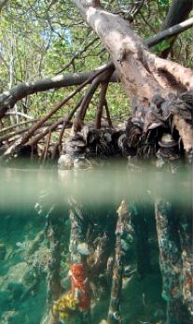

Example: Mangroves & Sponges
Mangroves can grow in salt water
Roots are colonized by sponges, algae, barnacles, etc.
Are there effects on the plants?
Q. Are there effects of sponges on mangrove growth?
E. Measured root growth in each of 4 treatments (n = 14):
Bare roots (Control)
Roots with artificial foam (Foam)
Roots with red fire sponge (Tedania)
Roots with Purple sponge (Haliclona)
Ellison et al. 1996
Gotelli & Ellison ch 10

Slide 76
Factors & Levels
One Factor: Treatment
Four Levels: 1 = Control
2 = Foam
3 = Tedania
4 = Haliclona
14 replicates in each group

Slide 77
Exercise 9: One-way ANOVA using mangroves
Import the data into a dataframe called mangroves using read.csv()
Using factor(), create a new variable (treatment.f) in the data.frame mangroves that converts treatment as a factor variable
Using lm(), fit a linear model that predicts growth based on treatment. Call it lm1.
Using lm(), fit a linear model that predicts growth based on treatment.f. Call it lm2.
Compare the two models using AIC()- which is better
Run TukeyHSD(aov(lm2)) – what do you conclude?

Slide 78
Exercise 9 Answer
mangroves <- read.csv('mangroves.csv')
mangroves$treatment.f <- factor(mangroves$treatment)
lm1 <- lm(growth ~ treatment,mangroves)
summary(lm1) #estimates of coefficients
anova(lm1) #overall effects of treatment.f
lm2 <- lm(growth ~ treatment.f,mangroves)
summary(lm2)
anova(lm2) #overall effects
AIC(lm1,lm2)
TukeyHSD(aov(lm2))

Slide 79
Changing reference level in ANOVA
contrasts(mangroves$treatment.f)
mangroves$treatment.f <- relevel(mangroves$treatment.f,ref='4')
contrasts(mangroves$treatment.f)
lm2a <- lm(growth ~ treatment.f,mangroves)
summary(lm2a)
http://www.ats.ucla.edu/stat/r/library/contrast_coding.htm

Slide 80
Other Stuff….
#formal analysis of variance
anova(lm1)
?aov() #alternative way of fitting anova models, allows for error strata
#post hoc test
TukeyHSD(aov(lm1))
Preplanned contrasts

Slide 81
Mangrove Example
What we want to know:
Do sponges aid plants by increasing root growth?
And, how do they do it – is it via physical or chemical mechanisms?
Group the treatments to enable us to answer these questions directly.
(1) If living sponge enhances root growth, then average of two living sponge treatments should > artificial sponge treatment.

Slide 82
Set Up Contrasts I and II
(I) Living vs foam: If living sponge enhances root growth, then average of two living sponge treatments should be > artificial sponge treatment.
Contrast | Control | Foam | Haliclona | Tedania
I | 0 | -1 | 1/2 | 1/2
(II) Control vs others: If physical aspects of sponge enhance root growth, then the control should be < the average of the three sponge treatments.
Contrast | Control | Foam | Haliclona | Tedania
II | 1 | -1/3 | -1/3 | -1/3
Check these are orthogonal: (0)(1) + (-1)(-1/3) + (1/2)(-1/3) + (1/2)(-1/3) = 0

Slide 83
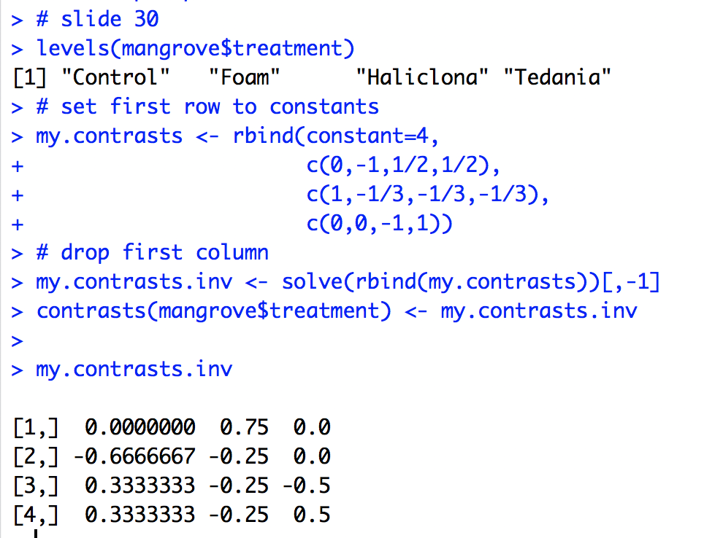
Coding Contrasts in R

Slide 84
ANOVA
>mangrove.model2 <- aov(growth~treatment,data=mangrove)
>anova(mangrove.model2)
Analysis of Variance Table
Response: growth
Df Sum Sq Mean Sq F value Pr(>F)
treatment 3 2.6014 0.86713 5.2807 0.002963 **
Residuals 52 8.5388 0.16421

Slide 85
ANOVA
ANOVA yields overall significance of treatment
Note: overall results will be the same regardless of how contrasts are set up

Slide 86
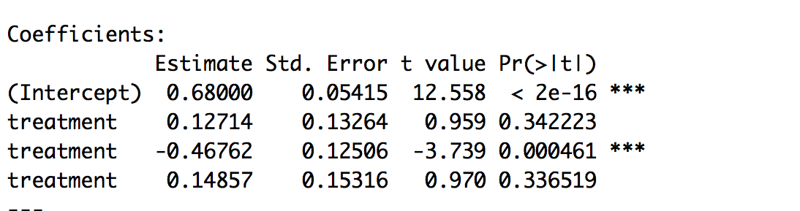
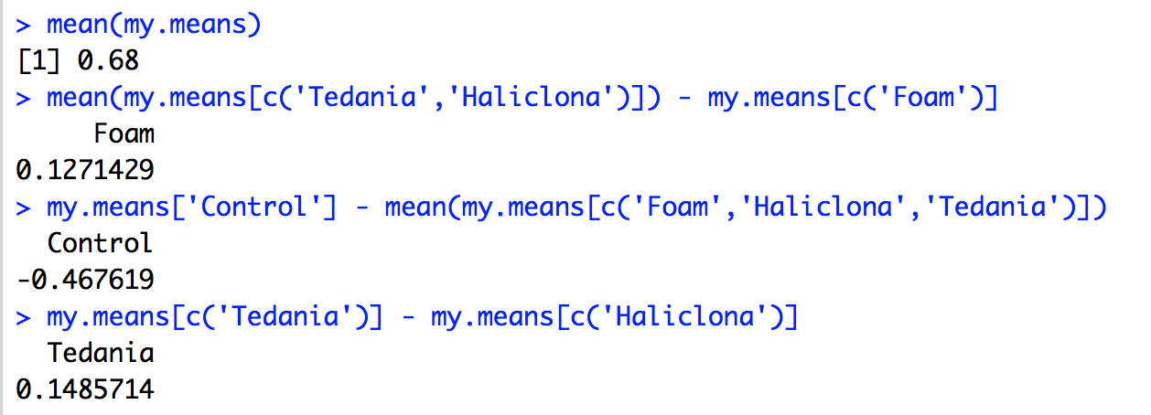
Evaluating Contrasts
>summary.lm(mangrove.model2)

Slide 87
Two-way ANOVA using Rat data
rats <- read.csv('rats.csv')
plot(time ~ treat + poison, data=rats)
interaction.plot(rats$treat,rats$poison,rats$time)
interaction.plot(rats$poison,rats$treat,rats$time)

Slide 88
Rat Data
g <- lm(time ~ poison*treat, rats)
anova(g)
qqnorm(g$res)
qqline(g$res)

Slide 89
Exercise 10
Transform the rat response to 1/time
Refit the model using lm
Undertake diagnostic residual plots to assess deviations from normality
Assess the significance of the interaction term by calling the function anova
Do treatments vary in effectiveness?
Do poisons vary in toxicity?
Does the success of treatment vary by poison?

Slide 90
Exercise 10 Answers
g <- lm(1/time ~ poison*treat,rats)
plot(g$fitted,g$res,xlab="Fitted",ylab="Residuals",main="Reciprocal response")
qqnorm(g$res)
qqline(g$res)
anova(g)

Slide 91
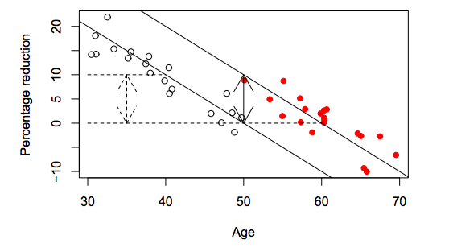
ANCOVA
Refers to regression problems where there is a mixture of quantitative and qualitative predictors

Slide 92
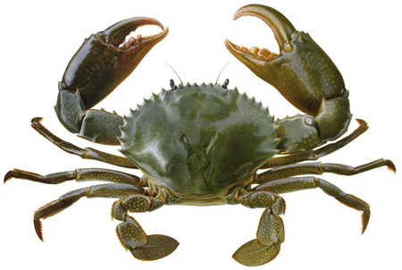
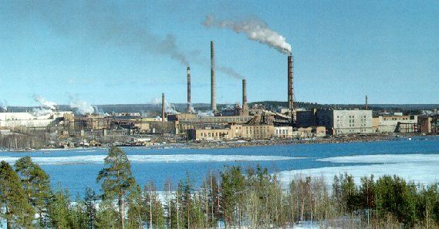
Dioxins in crabs
Dioxins are a byproduct of pulp-and-paper production
Carcinogenic
Persist for many decades in the environment
Dioxins are now banned in many countries

Slide 93
Worked Example: Dioxins in crabs
Dioxins can remain in the environment for decades
The following example is based on a real study
Government environmental protection agencies take samples of crabs from aﬀected areas each year and measure the amount of dioxins in the tissue.

Slide 94
Methods
Each year, four crabs are captured from two monitoring stations which are situated quite a distance apart on the same inlet where the pulp mill was located
The livers from all four crabs are composited together into a single sample
There are many diﬀerent forms of dioxin with diﬀerent toxicities, so a summary measure, Total Equivalent Dose (TEQ), is calculated.

Slide 95
Formulating the Question
Dioxin levels are given by D = log (TEQ)
The dioxin level starts at level D₀ and declines linearly with time, t :
Question: Did the two sites have the same initial concentration of dioxin?
Response Variable: D
Explanatory Variables:
Site (1 or 2) – categorical
Time (years) - quantitative

Slide 96
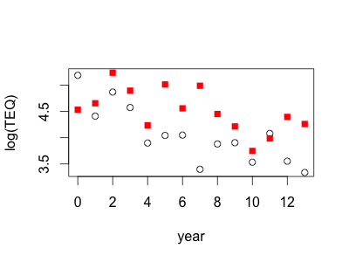
How do the data look?
> plot(dioxin$Year,dioxin$logTEQ,
xlab='year',ylab='log(TEQ)',type='n')
> points(dioxin$Year[dioxin$Site=='a'],
dioxin$logTEQ[dioxin$Site=='a'])
> points(dioxin$Year[dioxin$Site=='b'],
dioxin$logTEQ[dioxin$Site=='b'],pch=15,col=‘red’)

Slide 97
Exercise 11
Import the dataset dioxin
Perform a homogeneity of slopes test by fitting a model of the form lm(logTEQ~Year+Site+Year:Site,data=Year:Site)and evaluating significance of the length:style term using the function summary
If the slope difference is not significant, refit the model assuming a constant slope for both groups. Do the idiffer in height after controlling for length?

Slide 98
Further Information on ANOVA
http://goanna.cs.rmit.edu.au/~fscholer/anova.php
Provides details on how to partition variance, particularly with unbalanced designs
My recommendation: if your design is unbalanced, and you have two (or more factors), consider using Anova() function in car package

Slide 99
GLM

Slide 100
Many response variables are inherently non-normal
Counts (Integers >= 0; e.g. # of chicks)
Non-negative continuous variables (>=0; e.g. times between foraging bouts)
Proportions (0 <= P <= 1; e.g. proportion protein in the diet)
Binary (integer 0/1 for failure/success; e.g. prey capture during predation event; presence-absence of species)

Slide 101
Modeling counts
Poisson regression – simplest method; there are a number of extensions useful for count models (e.g. quasi-poisson)
Negative binomial regression – for over-dispersed count data, meaning that the conditional variance exceeds the conditional mean
http://cran.r-project.org/web/packages/pscl/vignettes/countreg.pdf

Slide 102
Modeling non-negative continuous variables
Exponential regression – assumes conditional distribution of response variable is exponentially distributed
Gamma regression – assumes conditional distribution of response variable is gamma distributed

Slide 103
Modeling proportions
Beta regression – Assumes conditional distribution of response variable is beta distributed
Unlike the other types of regression, beta regression can’t be conducted using glm()
http://cran.r-project.org/web/packages/betareg/vignettes/betareg.pdf

Slide 104
Modeling binary data
Logistic Regression – standard method, involves modeling binary data using the logit link function
Probit Regression – another frequently used method, involves modeling binary data using the probit link function

Slide 105
All of these different types of regression are GLM
Conditional distributions differ:
Poisson regression
Negative binomial regression
Logistic regression
Exponential Regression
Only link functions differ (both assume binomial distribution)
Logistic regression
Probit regression

Slide 106
Logistic regression
Old way: arcsine transformation proportion and try OLS regression
New (better) way: use logit (or probit) link with binomial errors
y
x
Source: www.zoology.ubc.ca/~srivast/zool502/Wkshp3-R.ppt

Slide 107
Logistic regression
p = proportion of successes
If p = e^{ax+b} / (1+ e^{ax+b}) calculate log(odds):
log_{e}(p/1-p)
Source: www.zoology.ubc.ca/~srivast/zool502/Wkshp3-R.ppt

Slide 108
Logistic regression
Output from logistic regression with logit link: predicted log_{e} (p/1-p) = a+bx
To obtain any expected values of p, need to input a and b in original equation:
p = e^{ax+b} / (1+ e^{ax+b})
Source: www.zoology.ubc.ca/~srivast/zool502/Wkshp3-R.ppt

Slide 109
Logistic regression analysis
Import the following file:
binary.csv
During import, make sure you specify the separator as comma
Recode rank from numeric to factor
View the dataset

Slide 110
Logistic regression analysis
Attributes of data:
This dataset has a binary response (outcome, dependent) variable called admit.
There are three predictor variables: gre, gpa and rank. We will treat the variables gre and gpa as continuous.
The variable rank takes on the values 1 through 4. Institutions with a rank of 1 have the highest prestige, while those with a rank of 4 have the lowest.

Slide 111
Logistic regression analysis
Code:
glm(formula = admit ~ gre + gpa + rank, family = binomial(logit), data = admit)
Predictors:
gpa + gre + rank
Response:
admit
Form:
Binomial response
Logit link

Slide 112
Logistic regression analysis: Summary with Wald Tests
glm(formula = admit ~ gre + gpa + as.factor(rank), family = binomial(link = "logit"), na.action = na.pass) Deviance Residuals: Min 1Q Median 3Q Max -1.6268 -0.8662 -0.6388 1.1490 2.0790 Coefficients: Estimate Std. Error z value Pr(>|z|) (Intercept) -3.989979 1.139951 -3.500 0.000465 *** gre 0.002264 0.001094 2.070 0.038465 * gpa 0.804038 0.331819 2.423 0.015388 * as.factor(rank)2 -0.675443 0.316490 -2.134 0.032829 * as.factor(rank)3 -1.340204 0.345306 -3.881 0.000104 *** as.factor(rank)4 -1.551464 0.417832 -3.713 0.000205 *** --- Signif. codes: 0 ‘***’ 0.001 ‘**’ 0.01 ‘*’ 0.05 ‘.’ 0.1 ‘ ’ 1 (Dispersion parameter for binomial family taken to be 1) Null deviance: 499.98 on 399 degrees of freedom Residual deviance: 458.52 on 394 degrees of freedom AIC: 470.52 Number of Fisher Scoring iterations: 4
Coefficients:
Estimate Std. Error z value Pr(>|z|)
(Intercept) -3.989979 1.139951 -3.500 0.000465 ***
gpa 0.804038 0.331819 2.423 0.015388 *
gre 0.002264 0.001094 2.070 0.038465 *
rank[T.2] -0.675443 0.316490 -2.134 0.032829 *
rank[T.3] -1.340204 0.345306 -3.881 0.000104 ***
rank[T.4] -1.551464 0.417832 -3.713 0.000205 ***
---
Signif. codes: 0 '***' 0.001 '**' 0.01 '*' 0.05 '.' 0.1 ' ' 1
(Dispersion parameter for binomial family taken to be 1)
Null deviance: 499.98 on 399 degrees of freedom
Residual deviance: 458.52 on 394 degrees of freedom
AIC: 470.52
Number of Fisher Scoring iterations: 4

Slide 113

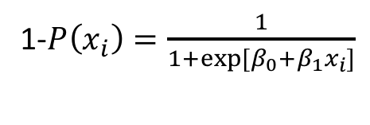
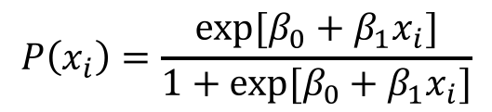
Calculating the Likelihood, L, for Logistic Regression
Success Data
$ln\left[\frac{P\left(x_{i}\right)}{1−P\left(x_{i}\right)}\right]$ = $β_{0}+β_{1}x_{i}$
$$P\left(x_{i}\right)=\frac{exp⁡[β_{0}+β_{1}x_{i}]}{1+exp⁡[β_{0}+β_{1}x_{i}]}$$
1-$P\left(x_{i}\right)=\frac{1}{1+exp⁡[β_{0}+β_{1}x_{i}]}$
Failure Data
$$L=\prod{P\left(x_{i}\right)}\prod{(1−P\left(x_{i}\right))}=\prod{\frac{exp⁡[β_{0}+β_{1}x_{i}]}{1+exp⁡[β_{0}+β_{1}x_{i}]}}\prod{\frac{1}{1+exp⁡[β_{0}+β_{1}x_{i}]}}$$

Slide 114
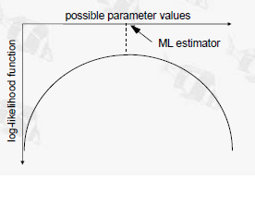


Maximum Likelihood
We can work out which hypothesis (i.e. which values of $β_{0}$ and $β_{1}$) has the maximum likelihood (ML) – that is, which hypothesis is most likely
Possible values for $β_{0}$ or $β_{1}$
(Use logs because it makes the calculation a lot simpler)
Quinn & Keough p 24

Slide 115
Exercise 13
Fit the full model, including gpa, gre, and rank, using glm
Assess the significance of each term in the model using drop1(…, ,test='Chisq')
Refit the model after dropping the term of lowest significance
Harder: plot the predicted P values of the model for a range of predictor variables

Slide 116
Exercise 13 Answers
g <- glm(formula = admit ~ gre + rank + gpa, family = binomial(logit), data = binary)
drop1(g, test='Chisq')
g <- glm(formula = admit ~ gpa + rank, family = binomial(logit), data = binary)

Slide 117
Plot of Model
gpa <- seq(2.26,4,length=100)
p1 <- exp(1.0521*gpa-3.4636)/(1+exp(1.0521*gpa-3.4636))
p2 <- exp(1.0521*gpa-3.4636-0.6810)/(1+exp(1.0521*gpa-3.4636-0.6810))
p3 <- exp(1.0521*gpa-3.4636-1.3919)/(1+exp(1.0521*gpa-3.4636-1.3919))
p4 <- exp(1.0521*gpa-3.4636-1.5943)/(1+exp(1.0521*gpa-3.4636-1.5943))
plot(gpa,p1,ylim=c(0,1),lty=1,type='l')
points(gpa,p2,ylim=c(0,1),lty=2,type='l')
points(gpa,p3,ylim=c(0,1),lty=3,type='l')
points(gpa,p4,ylim=c(0,1),lty=4,type='l')
legend('topright',legend=1:4,lty=1:4)

